Slide 1
Differential Leukocyte Count
Dr.Ghadeer Hamad

Slide 2
The Types of Leukocytes
1-Granulocyte cell :
a. Neutrophil: is a cell with fine pinkish red granules ,the nucleus is usually lobulated (3-5) lobes ,connected by thin chromatin filament .
Percentage 65-70%
Number 3000-6000 \ mm3.
Granules present.

Slide 3
Neutrophilia
increase Neu. In blood ex;
1.Acute infection
2.Intoxication
3. inflammation from tissue damage
4.Acute haemorrhage
5.Neoplastic cancer
Drugs??????????

Slide 4
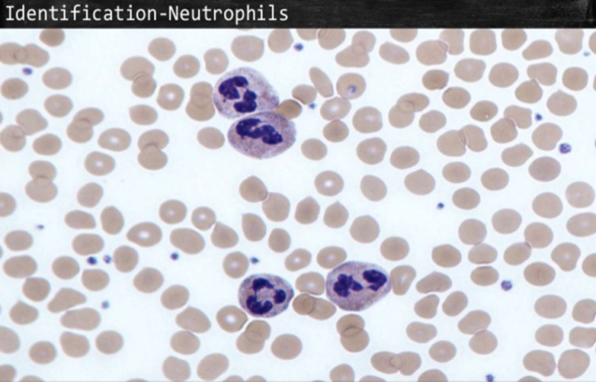

Slide 5
Eosinophil
b-Eosinophil: acidophilic cell ,usually larger than the Neu.,it is cytoplasm contain bright red granules or orange the nucleus consist usually 2 lobes or (bilobes).
Per. 2-4 %
Num. 150-300 \ mm3.
Granules present
Eosinophilia :ex: Allergy( Asthma, Hay fever).irradiation.

Slide 6
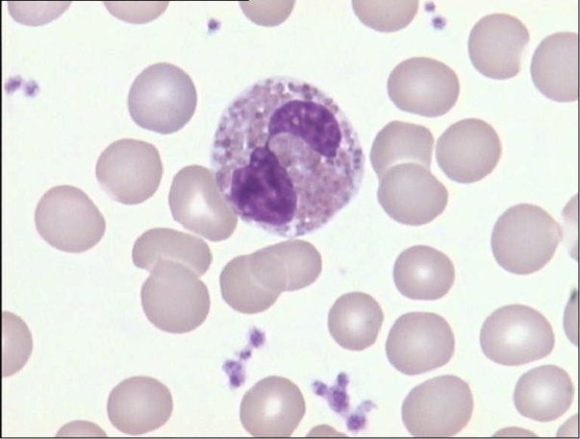

Slide 7
Basophil
c-Basophile :it is a small cell granules are black or blue in color and over cover most of the cell even the nucleus or (S-shaped).
Per. 0-1 %
Num. 0-100 \mm3
Granules present
Basophilia : ex: Wounds, ulcerative colitis and polycythemia vera

Slide 8
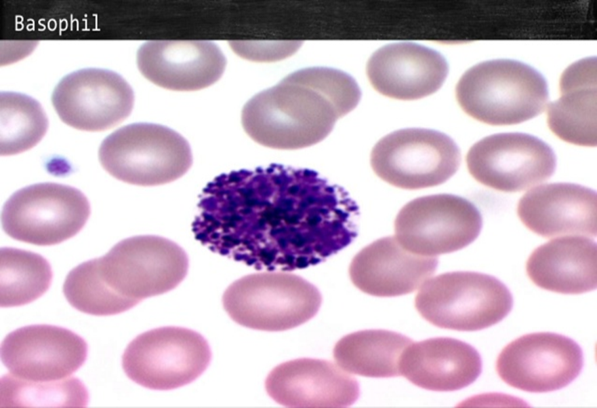

Slide 9
2- A granulocyte cell
a-Lymphocyte :it is also small cell ,the nucleus cover most of the cells &it is round dark violet in color ,the cytoplasm is usually blue in color with no granules .
Per. 32-40 %
Num. 1500-4000 \ mm3.
Lum.is divided into 2 types :T-cell(cytotoxic )
and B- cell(production of antibodies)
Disease Case :
• Lymphocytosis :increase lymphocyte in blood(Acute infection) ex :Tuberculosis
(chronic infection)ex; viral hepatitis

Slide 10
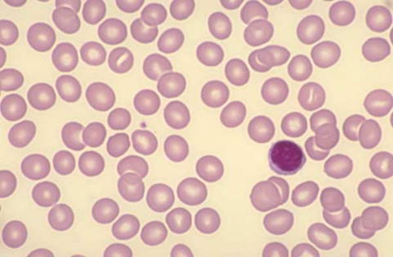

Slide 11
Cont.
b-Monocyte :is the largest mature leukocyte. its nucleus is usually kidney shape or horse shape .
Per. 5-8 %
Num. 300-600 \ mm3.
Granules absent
Monocytosis :ex: Malaria, Typhus, cancer of ovary.

Slide 12
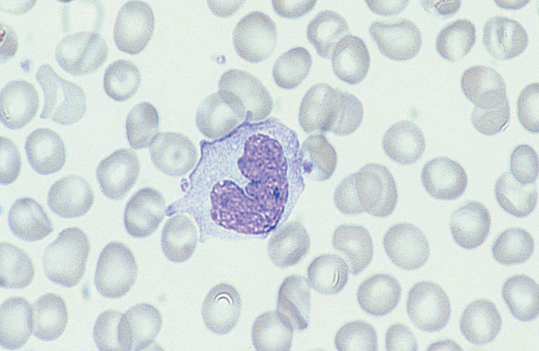

Slide 13
The preparation and examination of the blood Smear
1-Slide to Slide.
2-Coverslipe to Slide.
3-Coverslipe to Coverslipe.
4-Automated Spinner
There are 3 stains that used in differential leukocyte count :
1-Wright stain.
2-Leishman stain .
3-Giemsas stain.

Slide 14
The procedure of slide to slide

Slide 15
Procedure
Method of staining :
1-Put one drop of blood on the slide leave it for dry
2-Pour Leishman stain(2 drop) over the smear for 5 minutes.
3.Add 2 drop of D.w or buffer solution over the smear for 10 minute.
4-Wash off with Tap water and dry.
The dry and stained film examined without a coverslipe under oil immersion objective(100x) for differential leukocyte counts choose an area where the morphology of the cells is clearly visible.

Slide 16
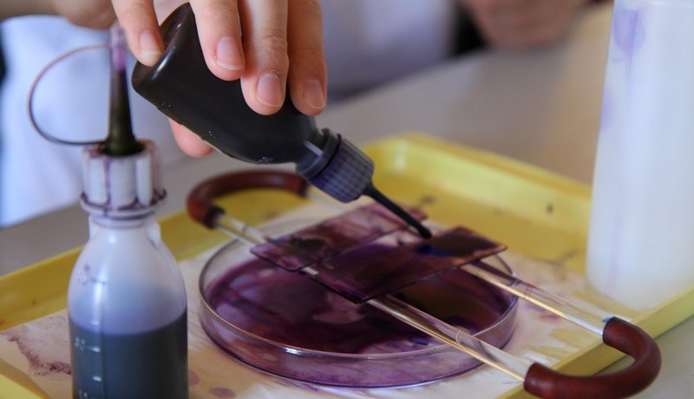

Slide 17
N | Neutrophils | Eosinophils | Basophils | Lymphocytes | Monocytes
1
2
3
4
5
6
7

Slide 18
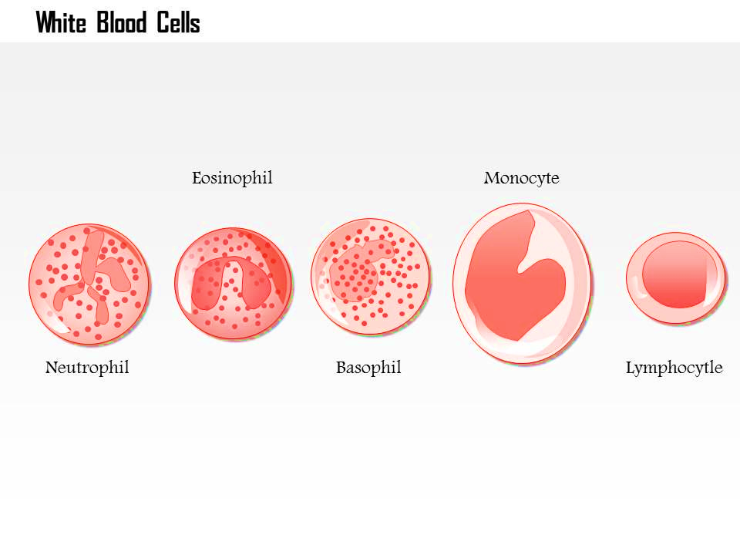
Thankyou

